Slide 1
Chapter 1: Introduction to Wellness Management in Hospitality and Tourism
Dr. Bendegul Okumus
Heather Linton Kelly

Slide 2
Learning Outcomes
Define health and wellness
Define wellness tourism and medical tourism
Discuss the differences wellness tourism and medical tourism
Discuss the impact of wellness travel on the global economy
Define primary and secondary wellness travellers
Identify core motivations for wellness tourism
Identify the main beneficiaries/stakeholders of wellness activities in the hospitality and tourism industry

Slide 3
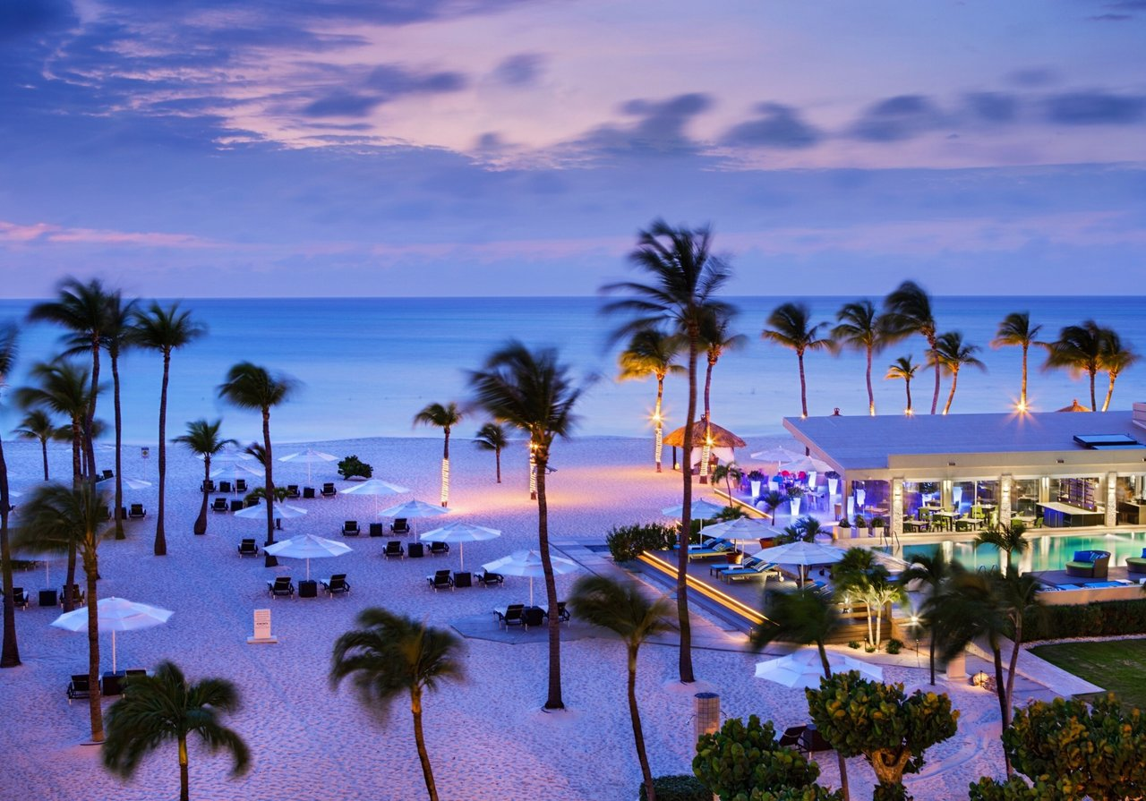
Case Study: Bucuti & Tara Beach Resort, Aruba
To learn more about the resort, click here.

Slide 4
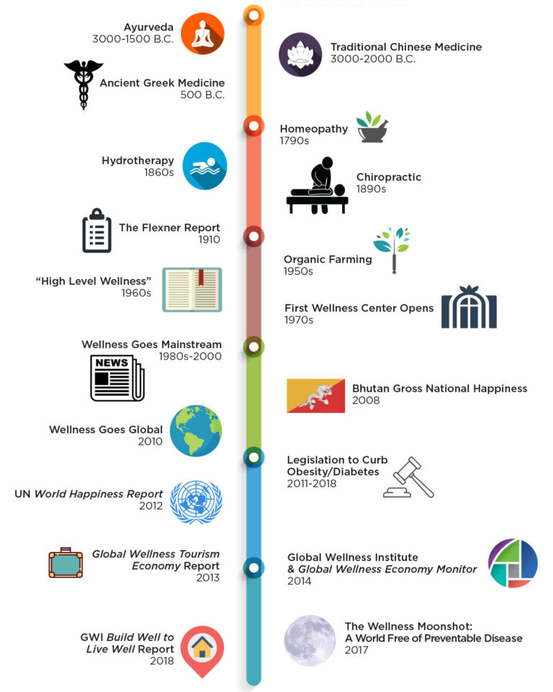
History of Wellness
Ancient wellness
Wellness defined & homeopathy developed
19th century intellectual & medical movements
20th century: Wellness spreads and get serious
21st century & beyond

Slide 5
The Value of Wellness
Wellness Tourism
$639b
Thermal / Mineral Hot Springs
$56b
Spa Economy
$119b
Wellness Real Estate
$134b
Traditional & Complementary Medicine
$360b
$4.2 trillion in 2017
Workplace Wellness
$48b
Fitness & Mind-Body
$595b
Personal Care, Beauty & Anti-Aging
$1,083b
Healthy Eating, Nutrition & Weight Loss
$702b
Preventive & Personalized Medicine and Public Health
$575b

Slide 6
What is Wellness in Hospitality and Tourism?
Any travel associated with the pursuit of maintaining or enhancing one’s personal wellbeing
Travel can bring stress, a change in routine and location, leading to health concerns
Wellness travel encourages rest and rejuvenation, extending and discovering more healthy lifestyles, identifying authentic and transformative experiences, preventing and managing disease or illness, and overall finding meaning, connection, and joy

Slide 7
Primary and Secondary Wellness Tourism
Primary Wellness Tourists | Secondary Wellness Tourists
Vacationing at a destination spa or taking a weekend spa trip Staying at a hot springs resort for multiple days Traveling to a wellness center for a comprehensive health check-up Staying at an eco-spa or jungle spa resort Staying at an ashram for a meditation or yoga retreat Attending a yoga retreat with healthy food and a natural setting Taking a wellness cruise | A business or leisure traveler who looks for healthy accommodations, food, and fitness options during a trip A family taking a vacation that spends a day at a hot springs establishment An adventure tourist who visits an eco-spa after a long day of hiking A vacationer staying at a beach resort who visits the salon and spa during their trip A member of a tour group who visits a hammam or receives a Thai massage or reflexology treatment as part of their itinerary A cruise tourist who selects a trip with spa, beauty and fitness amenities

Slide 8
The Bucket List Family
To learn more about the Bucket List Family, click here.
Notes:
Photo Source: https://medium.com/@garrettgee/the-bucket-list-family-travel-workout-and-diet-plan-61660c5533a1

Slide 9
Spectrum of Wellness Developments
Wellness-Themed Developments |  | Authentic Wellness Developments
In-room workout stations In-room fitness equipment Apps for guided training/meditation Supplements & shakes in minibars Adult coloring books/postcards | IN-ROOM FEATURES |  | In-room yoga & meditation stations Extension of the healing process (e.g. Vitamin C shower, Ozone-enriched air) No in-room snacks
Healthy food and beverage selection Private and group fitness & yoga classes Meditation programs Fitness concierge services & clubs Workout gear lending Bike rentals | SERVICES/ PROGRAMMING |  | Pre- & post-stay consultation Expert medical evaluations Custom food & beverage plan & workout sessions Twice-a-day meditation/yoga sessions Personal wellness concierge Educational workshops/seminars Sense of community Spiritual education
Collaboration with wellness/fitness brands Sustainability initiatives | OTHER INITIATIVES |  | Collaboration with medical clinics Wellness community standards Nature-oriented design standards Use of sustainable & ‘healthy’ materials

Slide 10
Wellness Travel Values and Activities

Slide 11
Stakeholders in Wellness Tourism
Hospitality & Tourism Infrastructure
Accommodation
Dining establishments
Destinations
Attractions
Arts & culture
Retail, gift shops, artisans
Transportation
Wellness Lifestyle
Healthy food & markets
Fitness & mind-body studios
Real estate (e.g. timeshare, vacation homes)
Nature & recreation amenities
Community & spiritual institutions
Wellness & Prevention
Spas
Health resorts & wellness retreats
Thermal/mineral hot springs
Centers for alternative medicine & integrative health centers
Government
Tourism
Health
Economic development
Investment promotion
Environment/sustainability
Social development

Slide 12
Top Wellness Tourism Destination Markets (2017)
Rank in 2017 | Country | Number of Trips (millions) | Direct Employment (millions) | Expenditures (US$ billions)
1 | United States | 176.5 | 1.88 | $226.0
2 | Germany | 66.1 | 1.13 | $65.7
3 | China | 70.2 | 1.78 | $31.7
4 | France | 32.4 | 0.31 | $30.7
5 | Japan | 40.5 | 0.18 | $22.5
6 | Austria | 16.8 | 0.16 | $16.5
7 | India | 56.0 | 3.74 | $16.3
8 | Canada | 27.5 | 0.29 | $15.7
9 | United Kingdom | 23.2 | 0.20 | $13.5
10 | Italy | 13.1 | 0.15 | $13.4

Slide 13
Medical-Wellness Continuum
Reactive Proactive
Medical Tourism | Wellness Tourism
Purpose is to receive treatment for a diagnosed disease, ailment, or condition, or to seek enhancement. | Purpose is to maintain, manage, or improve health and wellbeing.
Driven by a desire for lower cost of care, higher quality care, better access to care, and/or care not available at home. | Driven by a desire for healthy living, disease prevention, stress reduction, management of poor lifestyle habits, and/or authentic experiences.
Reactive to illnesses, medically necessary, invasive activities, and/or those overseen by a doctor. | Proactive, voluntary, non-invasive, and non-medical activities.

Slide 14
Health Continuum
Poor Health Optimum State of Well-Being
Medical Paradigm | Wellness Paradigm
Feel better | Thrive
Treat & cure illness | Maintain & improve health
Corrective | Preventive
Episodic | Holistic
Clinical-responsibility | Individual responsibility
Compartmentalized | Integrated into life

Slide 15
Summary
List five interesting things you have learned so far:
…
…
…
…
…

